Slide 1
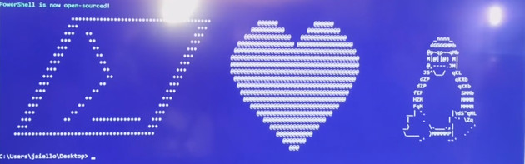
Start-NewEra.ps1 –Repo PowerShell
Ben Gelens, MVP, @bgelens, bgelens.nl, DevOps & Cloud Consultant @ InSpark

Slide 2
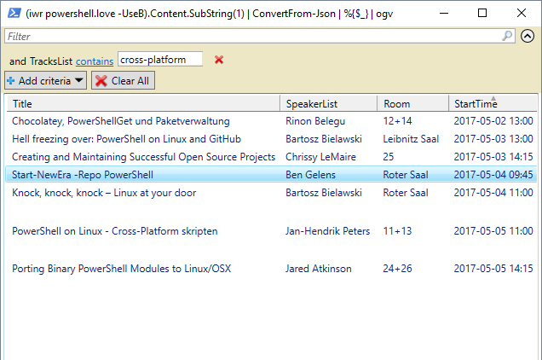

Slide 3
Agenda
Announcement
Important GitHub Repositories
Demos!
Summary
Questions

Slide 4



Announcement:
On August 18th2016 @ 11:14EST, PowerShell was made available on *NIX, OSX and Windows.
Current version: 6.0.0-alpha.18
Also, PowerShell now is OSS using MIT license!
PSRP over SSH!
Notes:
11:14 (14 November 2006) = Public Release PS1

Slide 5
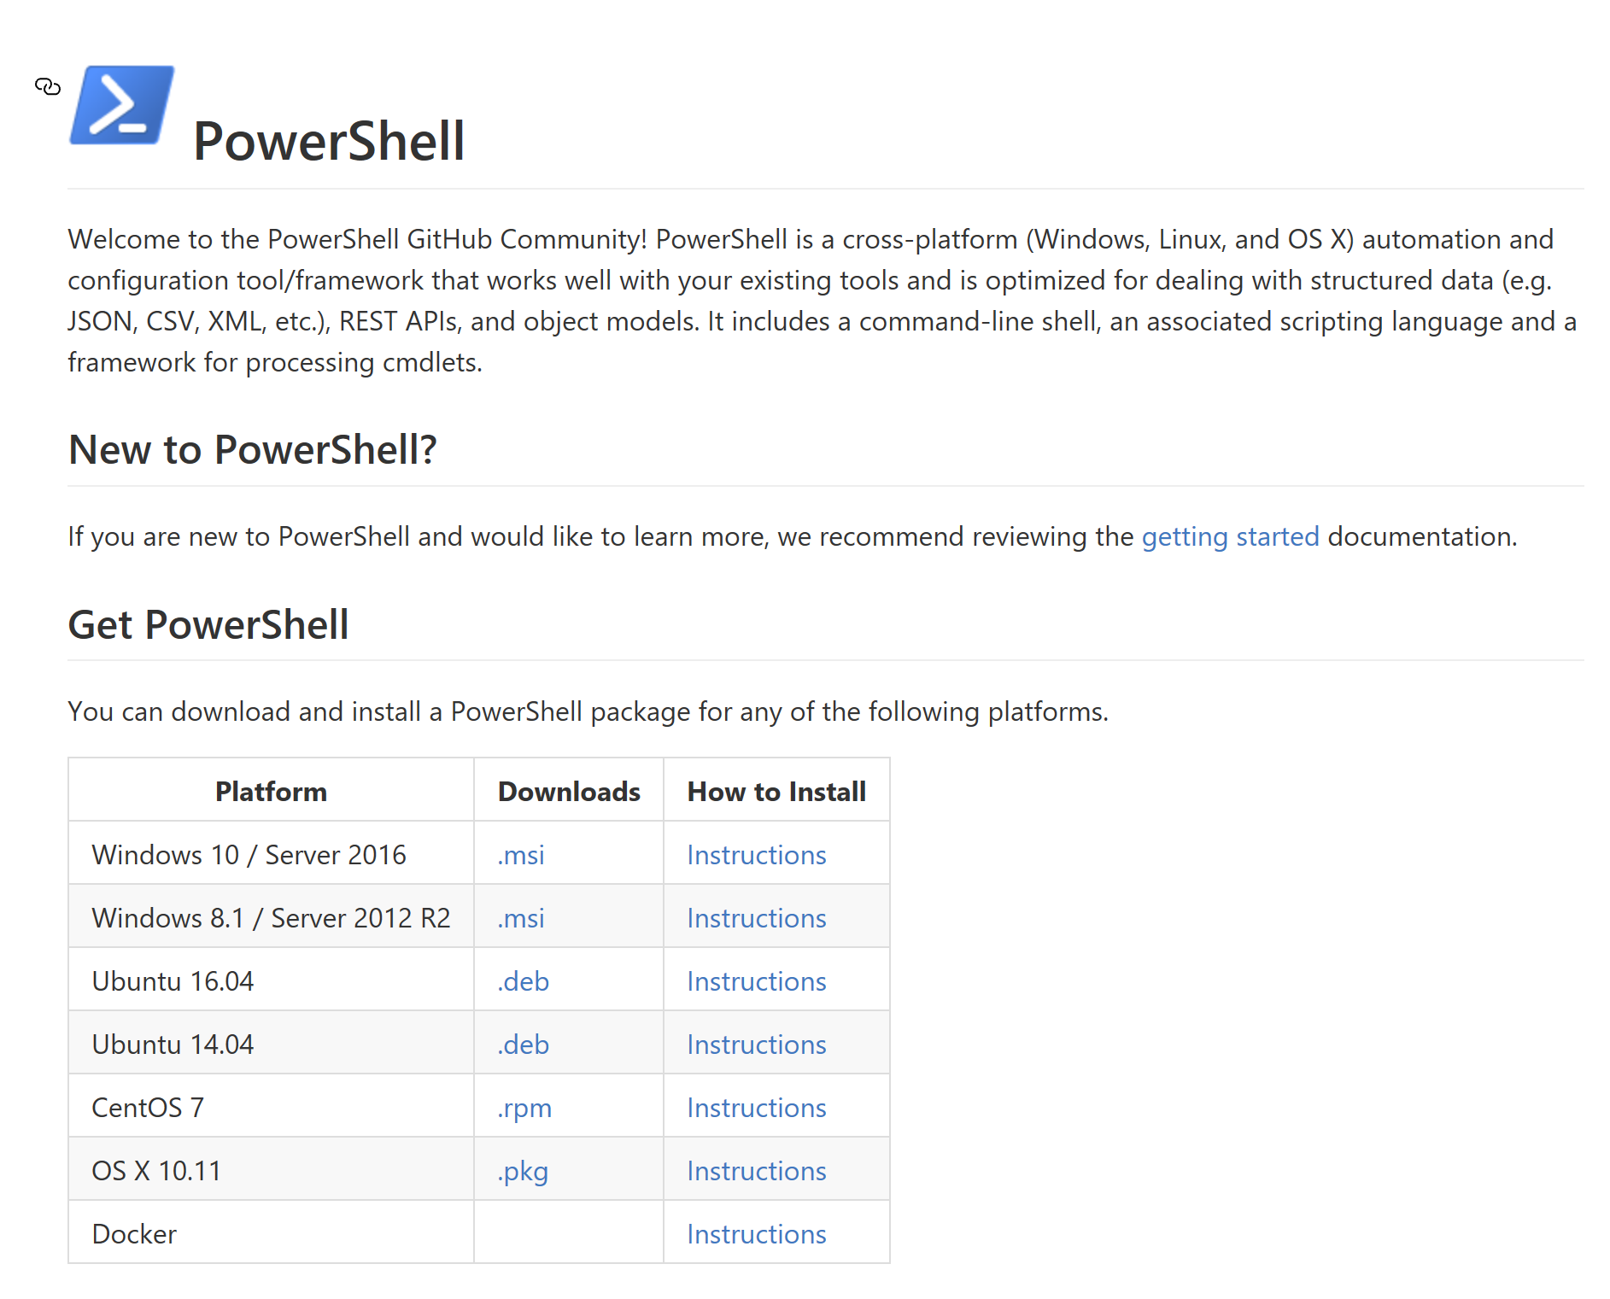

Important GitHub Repositories
https://github.com/..
* PowerShell/PowerShell
* Microsoft/omi
* PowerShell/psl-omi-provider
* Microsoft/PowerShell-DSC-for-Linux
* PowerShell/Win32-OpenSSH
* PowerShell/PowerShell-RFC

Slide 6





Slide 7


Summary

Slide 8
Next Steps...
Now: 15 min break
Grab a coffee
Stay here to enjoy next presentation
Change track and switch to another room
Ask me questions or meet me in a breakout session room afterwards

Slide 9
Questions?

Slide 10
Get-MyInfo
Name : Ben Gelens
Job : Consultant
MVP : CDM (PowerShell)
Company : InSpark
Email : ben@bgelens.nl
Twitter : @bgelens
GitHub : bgelens
Community : {Hyper-V.nu, azurestack.blog, DuPSUG}
Blogging : {bgelens.nl, Hyper-V.nu, PowerShellMagazine.com, azurestack.blog}

